Slide 1
Writing health advice in an EHCP for Children who have Down syndrome
Dr Shiela Puri, Consultant Paediatrician
Leeds Community Healthcare NHS Trust
Julian Hallett, Services Development Manager
Down’s Syndrome Association

Slide 2
Learning outcomes:
Understanding the aspects of an EHCP
Understand how specific health advice influences the outcomes for CYP who have Down syndrome
Contributing to annual reviews and transition reviews

Slide 3
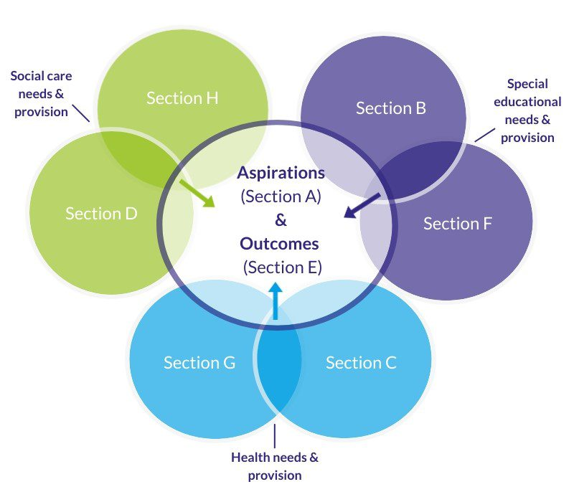
What is an Education, Health & Care Plan?
A | All about the CYP – The Voice
B | The special educational needs Cognition: Communication: Hearing: Vision: Physical Needs: SEMH
C | Health Needs: Impact on education
D | Social Care Needs
E | Outcomes
F | Educational Provision
G | Health Provision
H | Social care provision – 1 & 2
O | Voluntary & Community (O-other: Local variation)

Slide 4
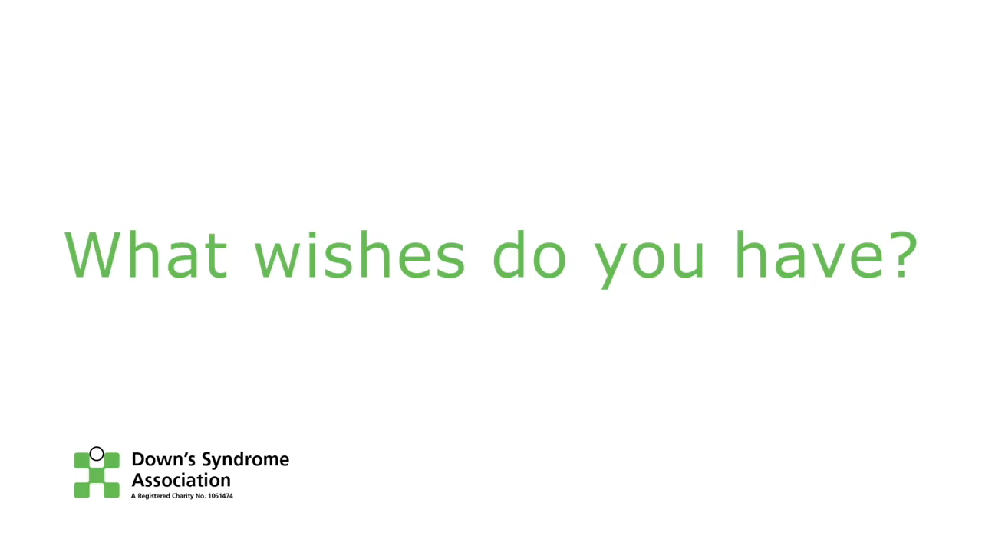
Capturing the voice of the child
Focused interview (You Tube clip)

Slide 5
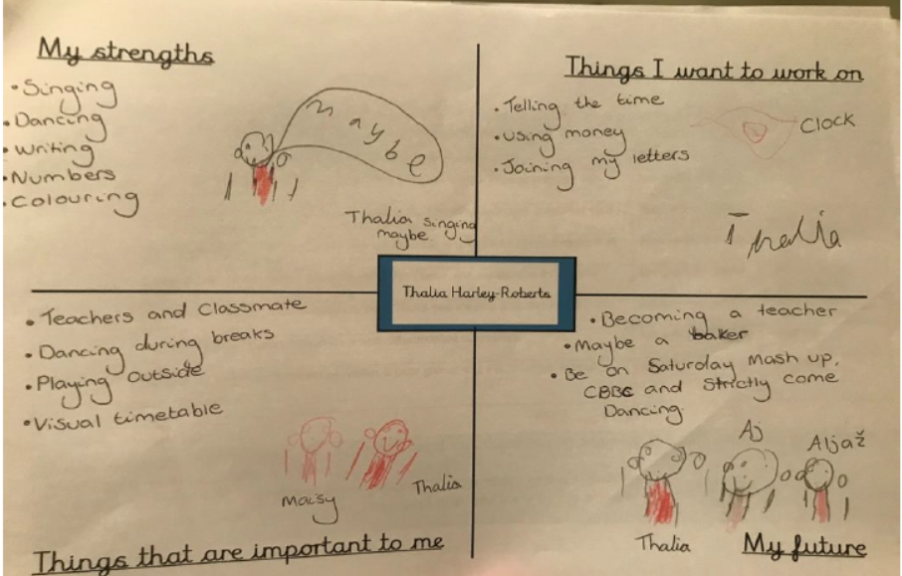
The voice of the child

Slide 6
Important ‘to’ or important ‘for’ – an crucial distinction
There is a difference!
Important ‘for’ a young person might be for them to improve their literacy skills.
Important ’to’ a young person might be to remain with their peer group of friends when they transition from primary to secondary school.
Sometimes EHCPs focus too much on the former and neglect the latter.
The ‘voice of the learner’ should guide you – what matters to the child or young person the most?
Reference http://helensandersonassociates.co.uk/person-centred-practice/person-centred-thinking-tools/sorting-important-tofor/

Slide 7
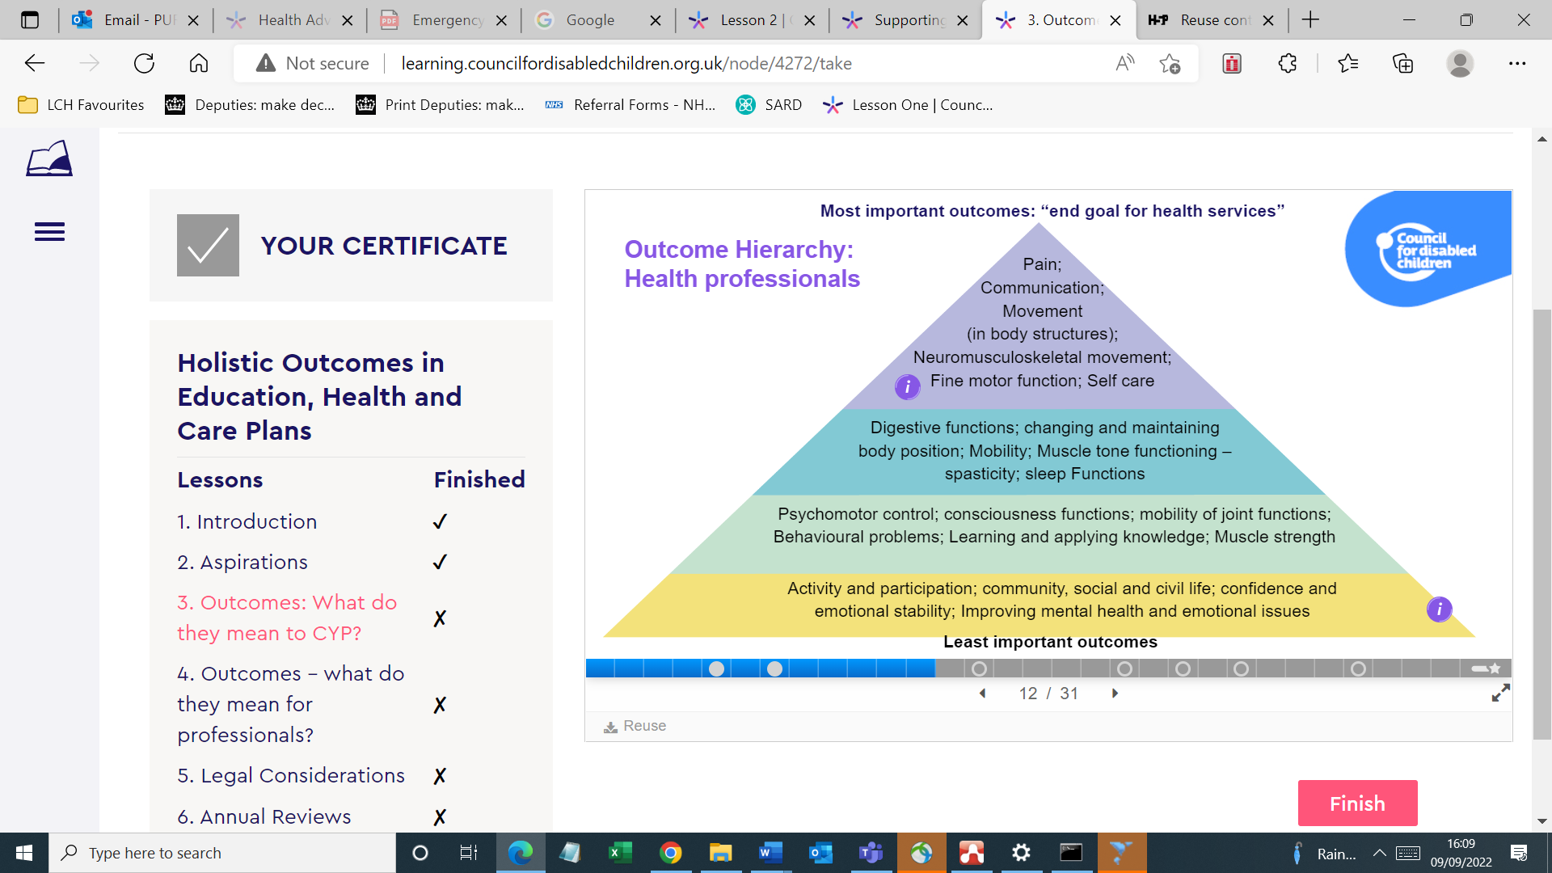

Slide 8
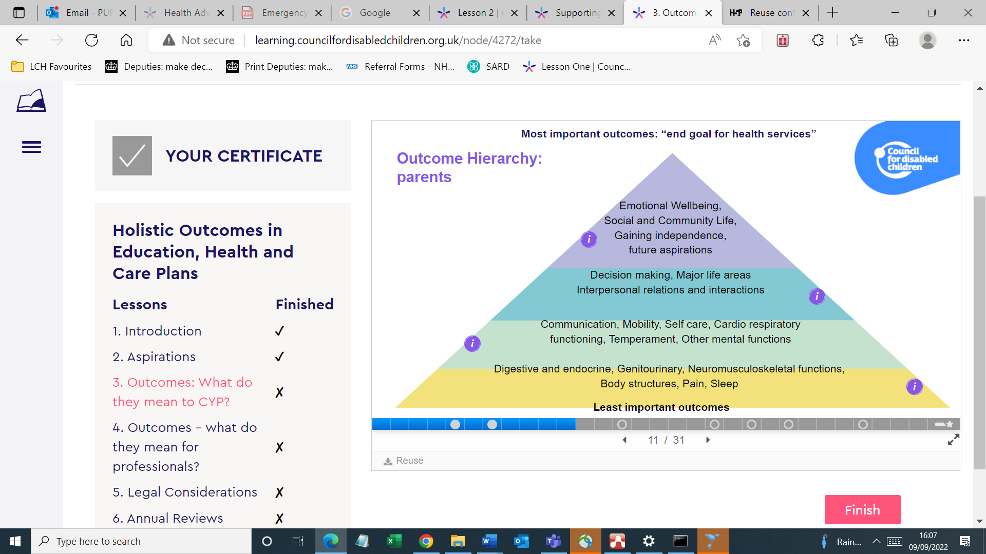

Slide 9
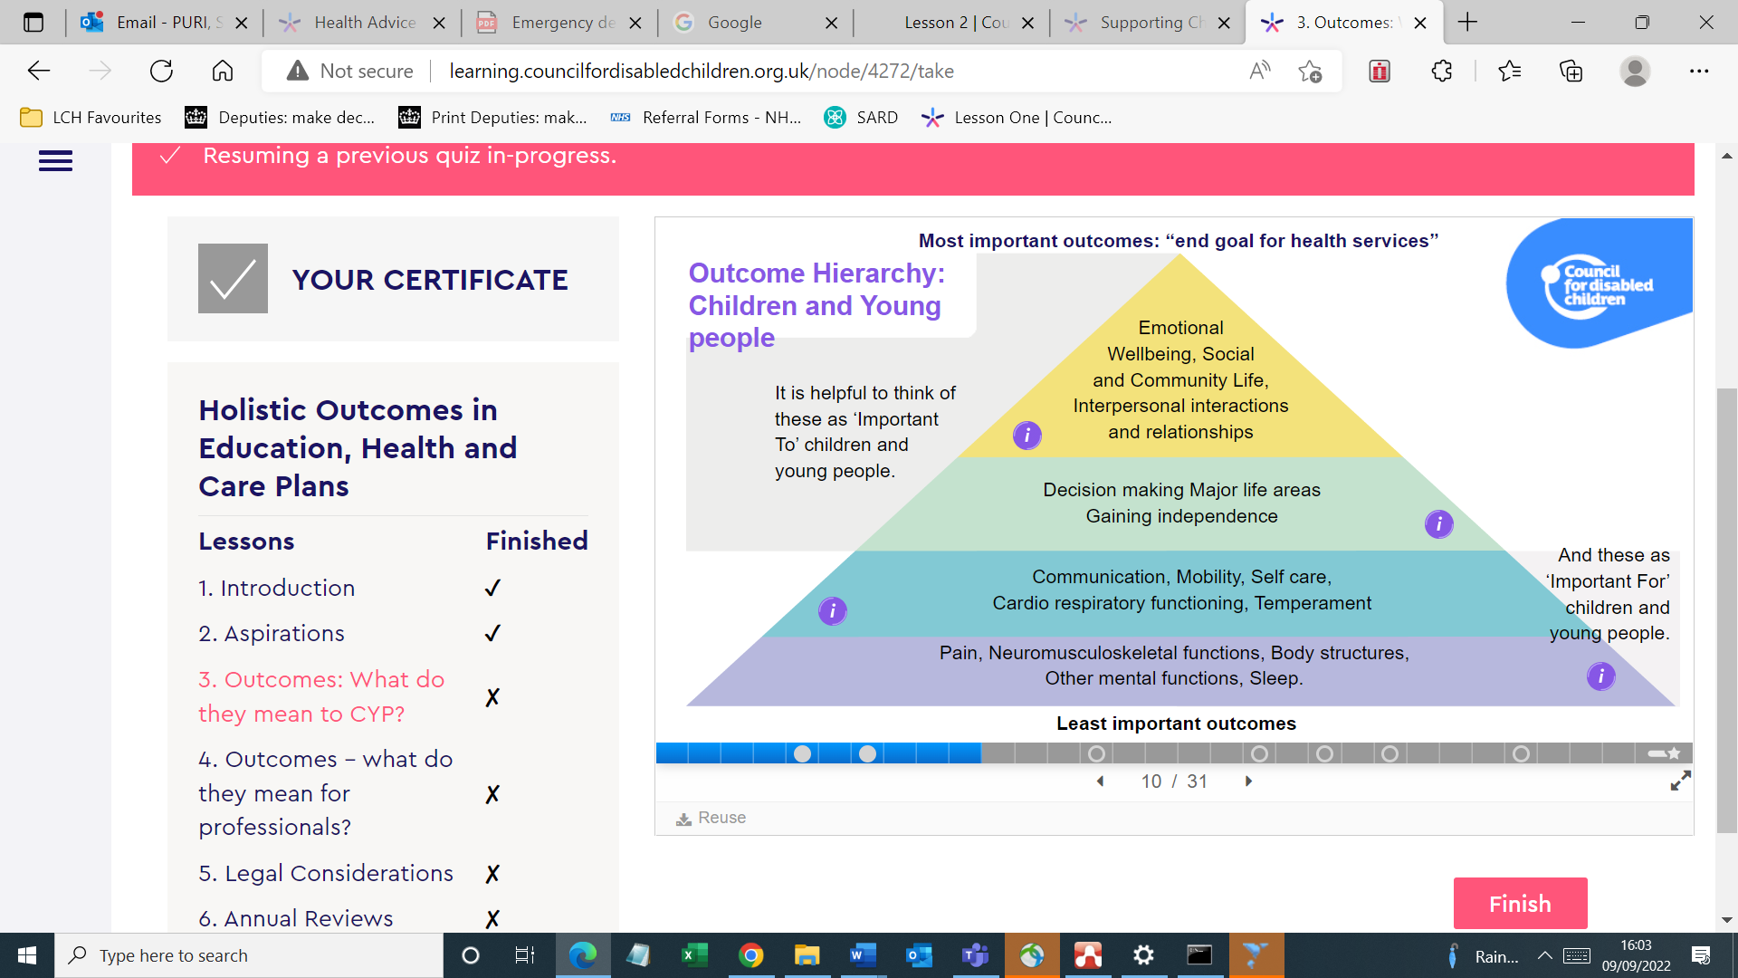

Slide 10
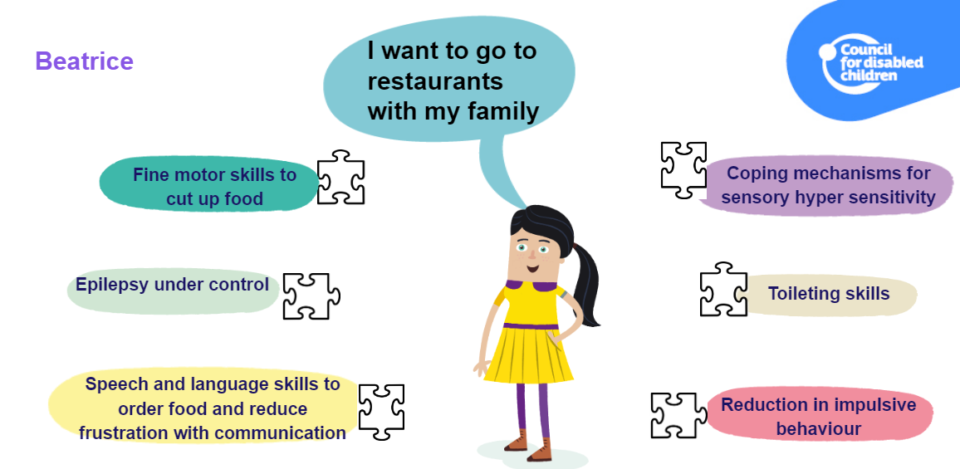

Slide 11
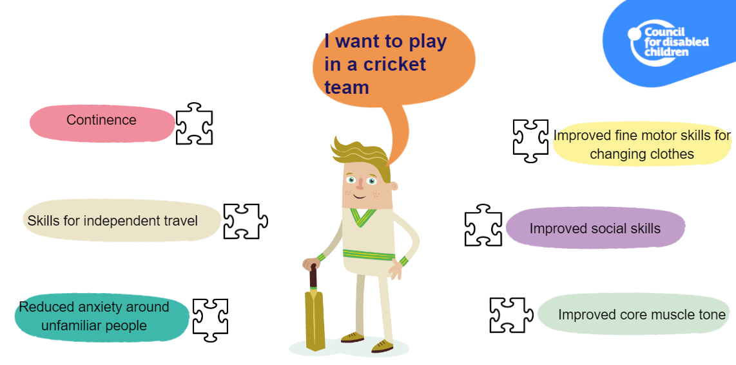

Slide 12
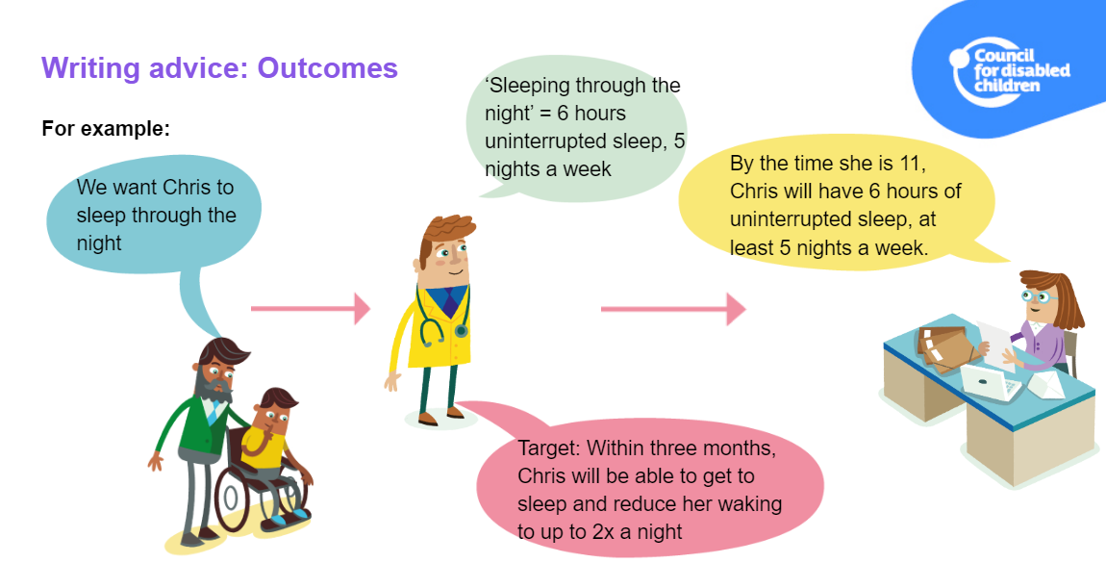
Notes:
This holistic, person-centred approach to outcomes is a significant cultural shift.
It relies on advice givers having sight of the child or young person’s aspirations and outcomes sought when they receive the request for advice.

Slide 13
Down syndrome
Specific health advice
Learning style
Communication
Sensory issues
Dual Diagnosis
SEMH
Vision
Hearing
Sleep
Constipation
Enuresis
Fatigue –Thyroid, Coeliac, OSA,Diabetes Leukaemia
Skin/Hair – impact on self esteem
Puberty – Relationships: Menstrual pain
Musculoskeletal issues: CSI, Arthropathy
Health issues related to cardiac, respiratory, infections etc
Diagnostic overshadowing
Importance of healthy eating & exercise (CSI)
Vulnerability
Health Literacy

Slide 14
Vision
CYP with Down Syndrome are visual learners but …
Nearly all have poor visual acuity.
Visual acuity remains poor even when wearing correctly fitted glasses for either long or short sight

Slide 15
Vision
Vision_kp.pdf (downs-syndrome.org.uk)
SEN: Unable to see clearly Health Need: Visual Impairment
Provision
Education: Learning materials
Use
  High contrast and visibility
  Use black ink on yellow paper
  Font size no less than size 18
Avoid
  Avoid faint lines in exercise books
  Badly photocopied sheets and yellow highlighter
Place CYP in near the front of class
Offer black ink pens to help them see what they write clearly
Check they can see the words in their reading books
(the size of print in books tends to get smaller as reading skills develop)
Seek advice from the Visual Impairment Service
Health: CYP should have a sight test at least every two years
Notes:
Health Need ; Wearing glasses
SEN need – Unable to see visual material
SEN provision: - As above
Health Provision – checking sight & correctly fitting glasses
Outcomes: Will wear glasses and will be able to access all visual material

Slide 16
Hearing
Hearing_kp.pdf (downs-syndrome.org.uk)
Health Need:
70% experience a hearing loss
CYP will be less able to recognise they have hearing difficulties and less likely able to explain what is happening to them
Hearing loss has a more serious impact on the development of speech and language in children who have DS than other children
Hyperacusis is common and may cause distress where there is a lot of background noise
Health Provision:
Offered a hearing assessment at least yearly
Offered appropriate hearing aids
Notes:
Possible signs of hearing loss in children who have Down’s syndrome are:
• difficulties with balance
• poking and rubbing ears frequently
• lack of response when their name is called
• discharge from ears and/or ears that smell
• looks at faces intently • may appear to hear some voices better than others because they are pitched differently
• finds it hard to follow a conversation in a group • background noise makes it harder for a child to hear conversation
• gets upset by loud noises
• jumps if someone whom they haven’t seen or heard comes up to them from behind • sits close to a TV or other screen and turns the volume up
• mouth breathes and has a blocked nose a lot of the time
• difficulty modulating the volume at which they speak (for example, speaks very quietly or very loudly)

Slide 17
Hearing
Hearing_kp.pdf (downs-syndrome.org.uk)
SEN: Unable to hear clearly
They may not be able to listen and carry out another task, such as writing notes or drawing, at the same time
SEN Provision
Place the child near front of class
Face the child, maintain eye contact, speak clearly and directly to the CYP
Reinforce speech with facial expression, sign or gesture and with a visual backup
Keep background noise to a minimum
Give the child time to respond to what you say
Keep the light on your face
Consider installing a sound field system
Seek advice from the specialist teacher of the deaf
All CYP should have a yearly hearing assessment
Notes:
place the child near front of class • to gain the child’s attention, use his/her name before giving an instruction or asking a question • speak clearly and directly to the child • face the child and maintain eye contact • reinforce speech with facial expression, sign or gesture • reinforce speech with visual backup – print, pictures, concrete materials (as well as highlighting key messages, visual prompts can be used to alert the child to a change in topic or activity) • make sure the child is focused on what you are talking about • check the child has understood • write new and key vocabulary on the board • when other children answer questions, repeat these answers aloud • rephrase or repeat words and phrases that may have been misheard • keep background noise to a minimum, work in a quiet environment and encourage the children to speak one at a time • speak clearly at a normal pace; avoid shouting or whispering • give the child lots of time to respond to what you say • keep the light on your face and don’t sit with your back to a window • your face should not be obscured, for example with a book or by moving around • consider installing a sound field system; this will benefit all children in the classroom not just the child who has Down’s syndrome and hearing loss • remember a child with hearing loss may not be able to listen and carry out another task, such as writing notes or drawing, at the same time • seek advice from the specialist teacher of the deaf

Slide 18
Health Resources
Down Syndrome Medical Interest Group website www.dsmig.org.uk
Health and Wellbeing - Downs Syndrome Association (downs-syndrome.org.uk)
Communications Series - Downs Syndrome Association (downs-syndrome.org.uk)
Understanding Behaviour - Downs Syndrome Association (downs-syndrome.org.uk)
Complex Needs & Autism - Downs Syndrome Association (downs-syndrome.org.uk)
Emotional Wellbeing - Downs Syndrome Association (downs-syndrome.org.uk)

Slide 19
Education resources
International Education Guidelines DSI Education Guidelines latest.pdf - Zoho WorkDrive (zohoexternal.com)
Info about EHCPs Education-Rights-Series-EHC-Needs-Assessments_kp.pdf (downs-syndrome.org.uk)
Transition to adult services
Ready Steady Go Easy Read - TIER Network

Slide 20


Slide 21
Case Study 1
Huw is 4 is due to start mainstream school
He has a hearing impairment and wears bi-lateral aids and a visual impairment
His parents are anxious because he is very adept at ‘escaping’ and has sometimes been found outside the family home if there is a momentary lapse in supervision.
He is a very sociable little boy, but gets frustrated if others cannot understand him and uses Makaton to assist his communication.
He isn’t yet toilet trained and the school have expressed some concern about this.
.

Slide 22
Case Study 2
11 year old girl
3 year old girl First child born in India at term, Mother 23 years old , migrated to UK at 2 years old with her parents and younger brother
Development: Sat 8/12, Pulled to stand 12/12, walked at 2 yrs, toilet trained by 2.5 yrs, 2 word phrases aged 2
No parental concerns, developmental concerns raised by health visitor: Diagnosed Down syndrome aged 3.5
Health : Pneumonia, otitis media, dental caries
Social History: Both parents had limited English Father Chef – worked around the country; Only father could drive, no relatives in UK
Not brought to several appointments
Moved around the country

Slide 23
Case Study 2
Aged 5.5 years Reluctant to walk ? Hip Pain
Seen by General Practitioner: Down syndrome
School contacted our team
Investigated
  Microcytic iron deficiency anaemia, Vitamin D Deficiency:
  Hypothyroidism TFT: TSH 75, fT4 9.1
  Commenced on thyroxine, iron & Vitamin D pain subsided
Aged 6.5 years school expressed concern: less communicative & withdrawn
  Requested repeat hearing assessment
  Moderate conductive hearing loss: Fitted with BAHA’s
  Outcome: Learning improved, more communicative

Slide 24
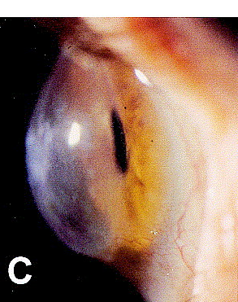
Case Study 2
Aged 8.5 years returned from India
  Weight loss, lethargic, recurrent infections
  No malaria prophylaxis, No Travel immunisations: Typhoid & Hepatitis
  Investigated: Coeliac positive, HLA- DQ2 positive, Iron deficiency anaemia, Vit D def
Aged 11yrs seen for routine eye check asymptomatic
  Blue Dot cataract and Keratoconus 0.05% vs 5 % in DS
Parents main concern:
Vulnerability & Independence as an adult
Young Person:
Dancing and playing with brother

Slide 25
Case study 2
What’s important to Naini? To be understood by adults with whom she comes in contact with To play with her peers and be happy To play outdoors and climb the school equipment To be healthy To be safe Dancing

Slide 26
Case study 2
What’s important for Naini? For adults supporting her to be able to communicate effectively with her For her to be able to communicate effectively with adults and her peers For her to gain skills that promote independence For her to be taken to all her health and dental appointments

Slide 27
EHCP
A | Dancing; Playing with Peers; Safe: Integrate within school life
B | Cognition: Visual Learner; Communication: Makaton in all environments Hearing: Hearing impairment – wearing aids Vision: Visual impairment Physical Needs: Due to recurrent OME – balance Able to participate in all activities mindful of CSI, Arthropathy Fine motor skills : Help with eating and drinking SEMH: Self esteem
C | Health Needs: Impact on education Specific: Dental Caries, Vision, Hearing, Thyroid, Coeliac
D | Social Care Needs: Out of school activities, Isolation
E | Outcomes: To be able to dance integrate with peers
F | Educational Provision
G | Health Provision- Medical, dental, hearing, vision checks OT
H | Social care provision – 1 & 2
O | Voluntary & Community : Parent support groups, Brownies

Slide 28
Key Take Home Message
  Parents and professionals may attribute presentation to ‘Down syndrome’ or ‘Intellectual Disability’
  Provide specific advice and sign post to resources
  All medical conditions are over represented in Down syndrome
  Children may not be able to communicate effectively
  If there is change in behaviour assess for sensory impairments
  Aspire high

Slide 29
Summary
The voice of CYP and their aspiration is central
Advice giver’s role is to consider provision that will meet the CYP needs to achieving their outcomes
Outline impact of health need on CYP on accessing education
Provision to remove barriers to learning to achieve their outcomes and aspirations.
Provision based on child’s needs not services available
SMART jargon free advice within your specific professional specialism

Slide 30
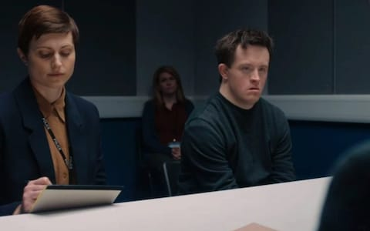
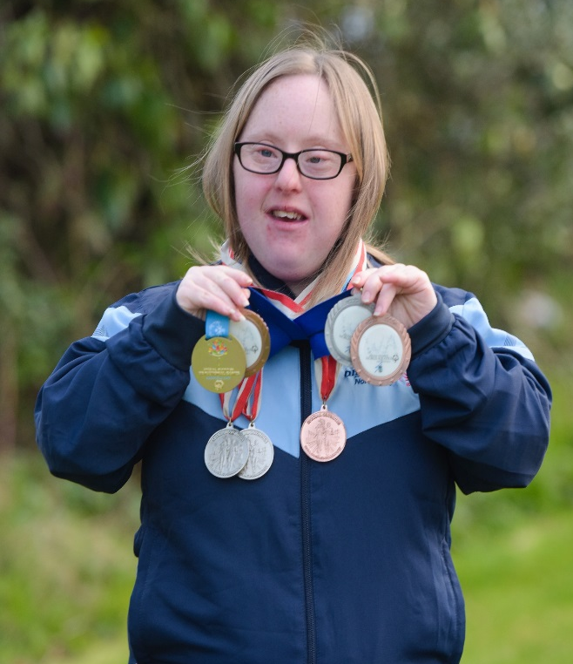

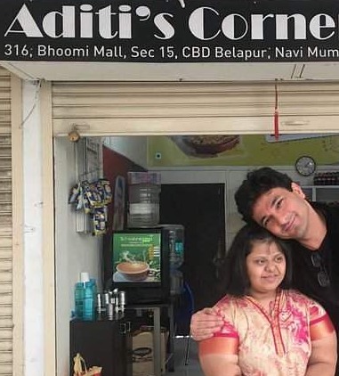
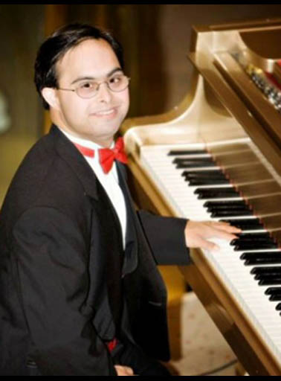
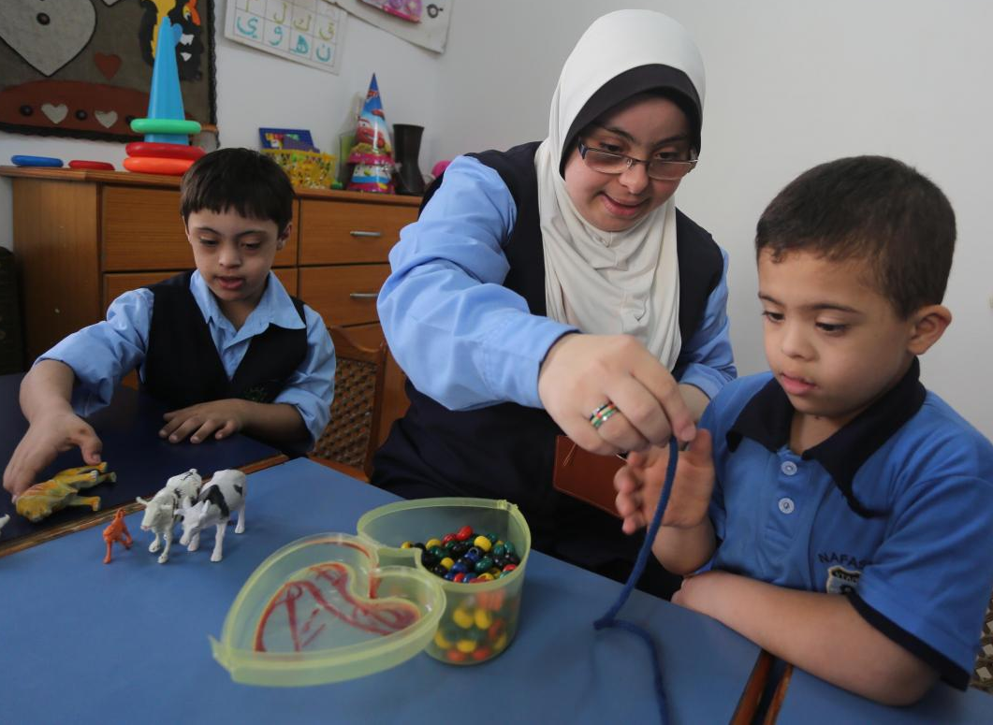
Tommy Jessop: Line of Duty
The full moon: The enchanted forest D Cormack
Shona Hogan Swimmer
Face of Para Olympics 2021
Surjeet Desai mastered 7 instruments
Heba el-Shurafa helps her students during a lesson: Gaza
Notes:
Tommy Jessop in the first series of Line of Duty: Full voting rights in BAFTA

Slide 31
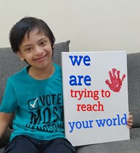
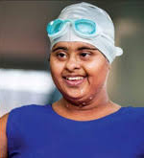

I always say I am Pablo Pineda and that I have Down syndrome. There is a big difference between 'having' and 'being.' 'Being' can crush you down and 'having' shows it is only one feature."

